Slide 1
By SAMUEL MALIK For Pairview Consult UK
Adventure Works Group
Data Science Project Presentation

Slide 2
Adventure Hardware group
Dashboard . Recommendation Engine . Predictive Model

Slide 3

Table of Content
Executive Summary
Business Benefits
Final Recommendation
Methodology
Dashboard
Approach
Churn Predictive Model
Recommendation System

Slide 4

Executive summary
The 3 tools built in this project will empower the management of AHG to make data driven decisions, and in-turn increase the commercial value of the business
The Reporting Dashboard will enable a single window summary of the business activity, which will significantly reduce the decision-making time
.
Build a recommendation engine solution, that will automatically recommend a product to a customer based on their purchase history
To develop a predictive model to automatically notify AHG leaders 90 days before a customer is due to churn, using 8 months as a baseline to become a churner.
This Photo by Unknown Author is licensed under CC BY

Slide 5
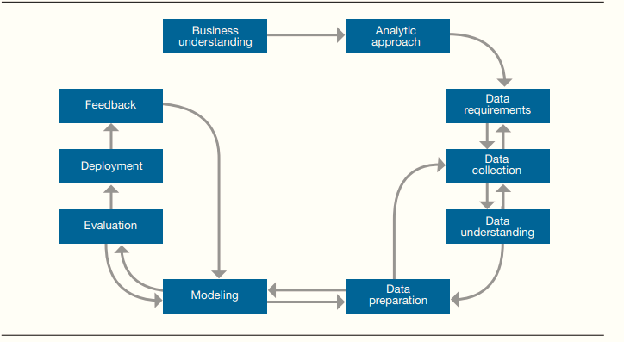
methodology

Slide 6
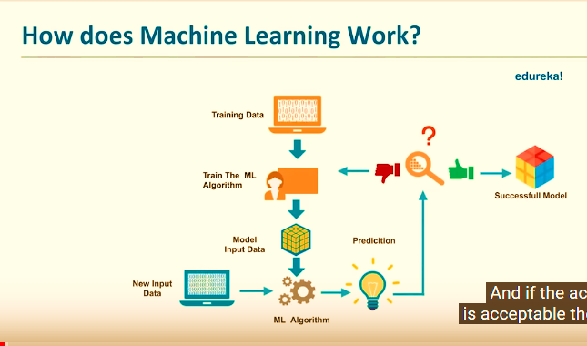
methodology
Machine Learning Process Flow

Slide 7
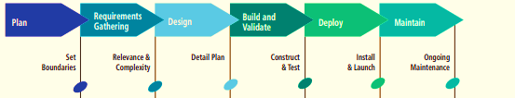
Dashboard
Data was extracted from AdventureDW using SQL
Data Wrangling
Cleaned Data imported/Incorporated/extracted to Microsoft PowerBI for analytics, Visualization & Presentation
Notes:
Consider talking about:
Human perception/cognition and data visualization

Slide 8
Recommendation engine
Data sourced from SQL server
Collaborative model was deployed.
Turicreate library was used to build the model

Slide 9
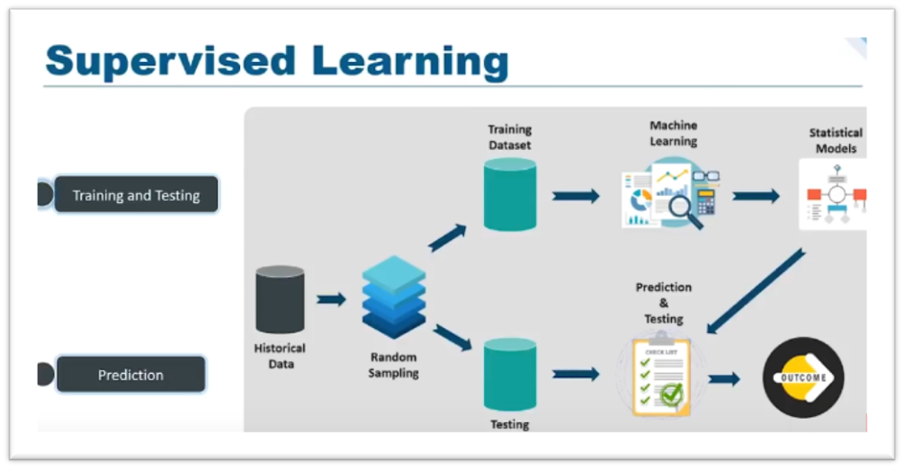
Predictive model
Model Validation

Slide 10
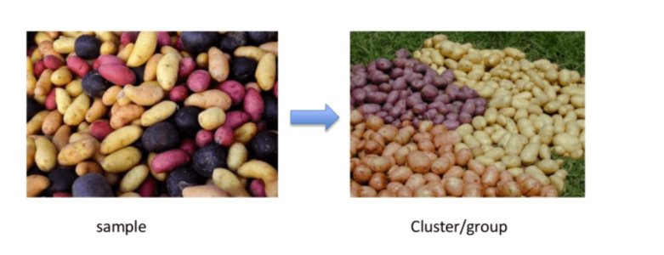
Predictive model
UNSUPERVISED LEARNING
Clustering
Hierarchical clustering
K-means clustering
K-NN (k nearest neighbors)
Principal Component Analysis
Singular Value Decomposition
Independent Component Analysis
Association
Groups of shopper based on their browsing and purchasing histories
Movie group by the rating given by movies viewers

Slide 11



approach

Slide 12


1. Reporting dashboard

Slide 13
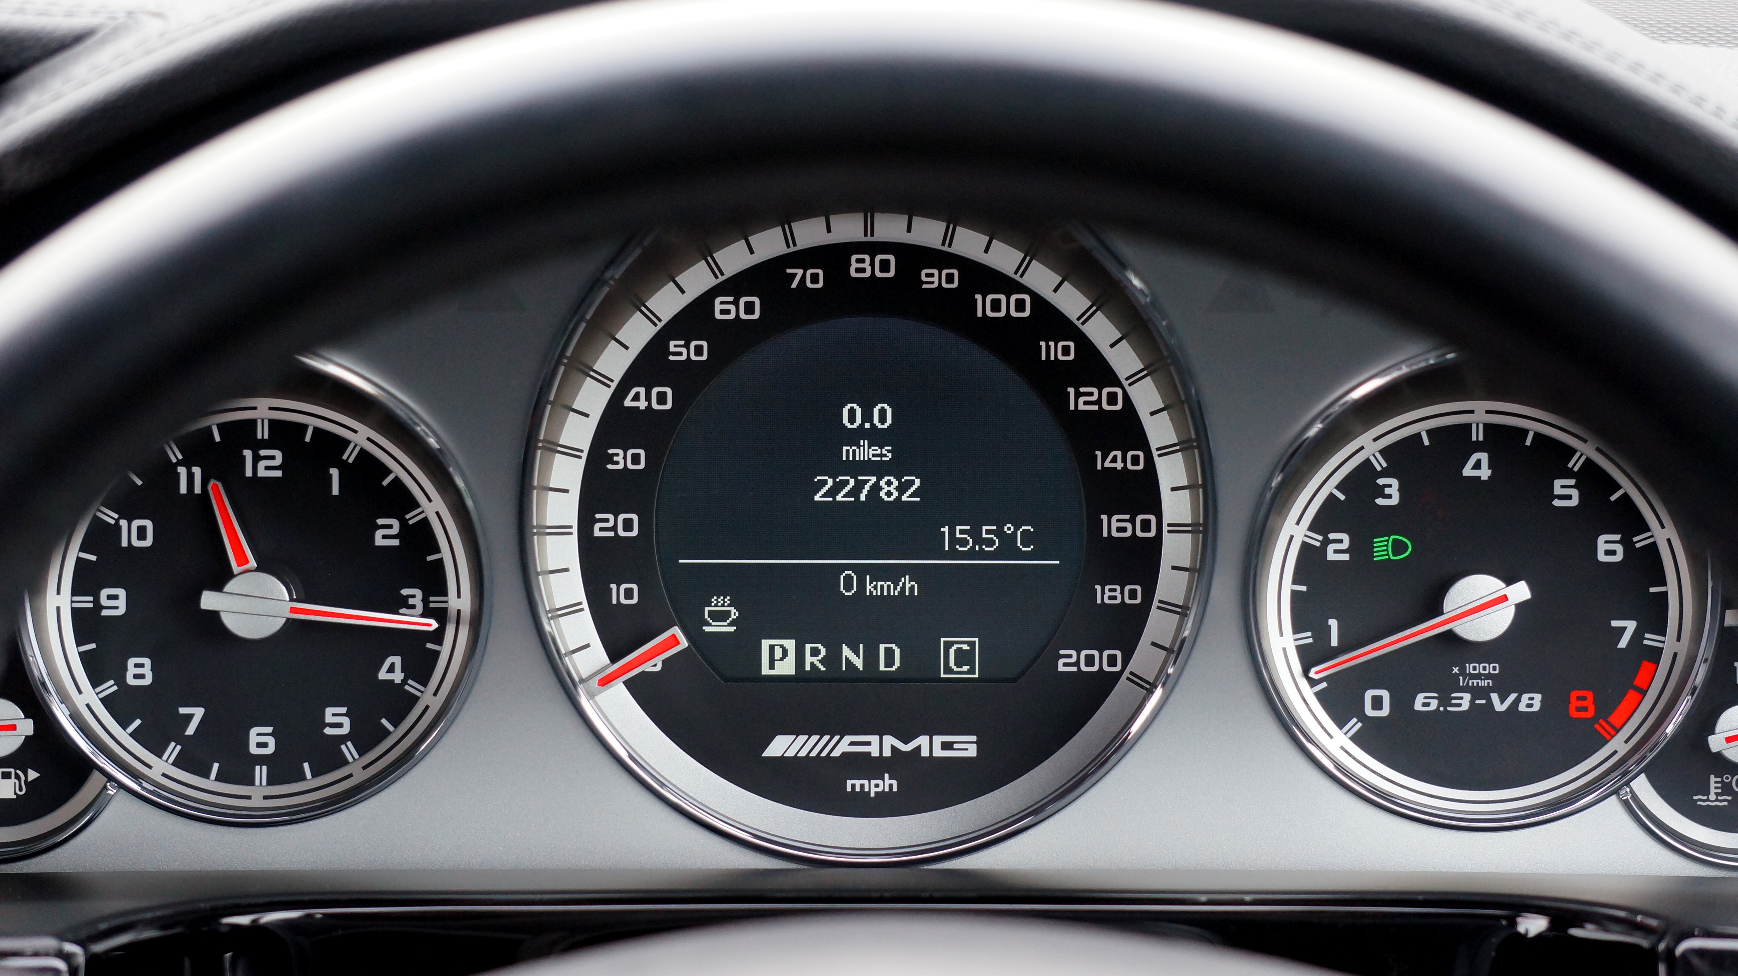
As a global manufacturer and seller of bikes and bike accessories AHG continuously generates enormous data everyday - across 6 countries and 4 product categories The Dashboard will enhance AHG all round visibility to all business parameters indicators, time saving efficiency, Better forecasting, Inventory control and Real-time customer analytics It will provide The management of AHG the needed visual, intelligent and real-time insights of the business performance A dashboard with a clean and intuitive interface, highlighting key performance indicators – will define and support AHGs business decisions
Purpose of the dashboard

Slide 14
Dashboard (The Flow)
Data was moved from SQ server using direct Query option
A comprehensive SQL script was written to bring in six tables together
Some featuring engineering were done using SQL code like Profit column.
Data was cleaned properly prior loading
DAX formula was applied to get year, month etc.
Age Band was created, using conditional formating:

Slide 15
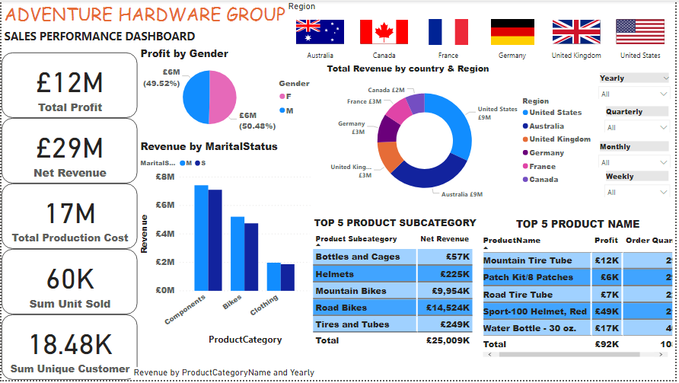
AHG DASHBOARD

Slide 16
2. Recommendation engine

Slide 17
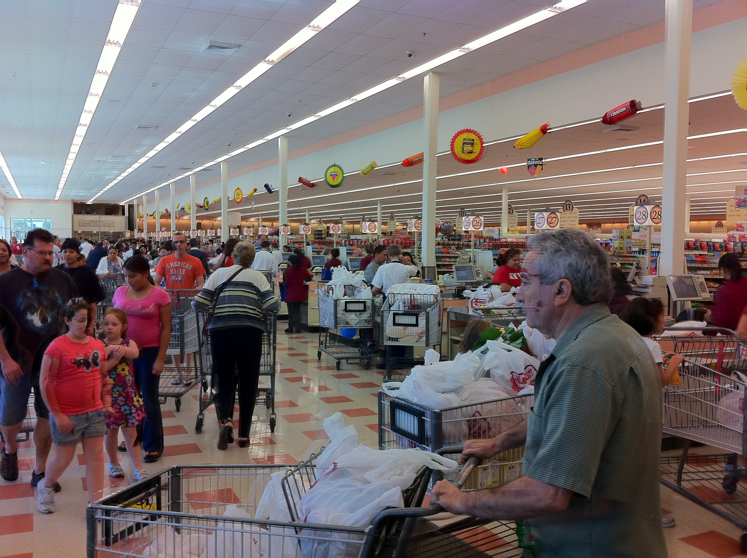
Need for a Recommendation Engine
AHG has been selling bikes online over the last 4 years. Last year they introduced clothes and accessories as new categories online
Online sales are account for 1/3rd of the Net Revenue and 11.8 million net profit
The key focus now is to increase each customer basket value and in turn, increase the revenue and profits from the online channel
The tool will be able to search for a recommendation list based on a specified user, such that: Input: customer ID Returns: ranked list of items (product IDs), that the user is most likely to want to put in his/her (empty) “basket”
This Photo by Unknown Author is licensed under CC BY-SA

Slide 18
Methodology
Transforming and normalizing data
Training models
Evaluating model performance
Selecting the optimal model

Slide 19
Recommendation Engine
80% of data set was used to training the model and 20% for test.
Alternating Least Square (ALS) is a matrix factorization algorithm and it runs itself in a parallel fashion. ALS uses L2 regularization .
ALS minimizes two loss functions alternatively; It first holds user matrix fixed and runs gradient descent with item matrix; then it holds item matrix fixed and runs gradient descent with user matrix
Training data is used for model selection
For evaluating recommendation engines, the concept of RMSE was applied

Slide 20
Top 3 Customers with Average Recommendation
Top 3 Customers with Average Recommendation
Customer ID | Full Name | Average Recon Product | $ Revenue
11000 | John V. Hang | 11 | 330,787
11001 | Eugene L. Huang | 14 | 550,007
11002 | Ruben Torres | 9 | 407,898
80% of data set was used to training the model and 20% for test.
AVG REVENUE $1,288,692
JOHN $330,787
EUGENE $550,007
RUBEN $407,898
With an Average of 34 product the revenue increased

Slide 21
3 predictive model

Slide 22
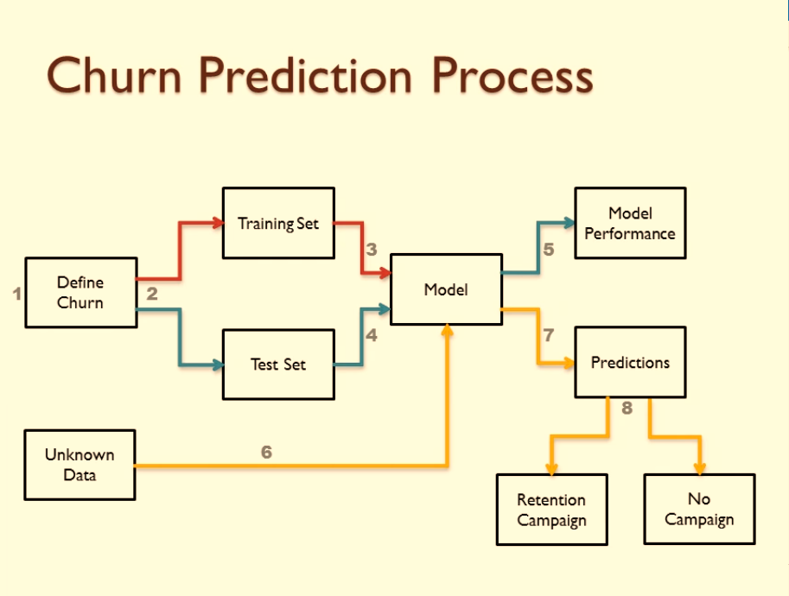
Churn model

Slide 23
Churn model
All Customers 18484
Non-Churners (0)
69.7% (12876)
Churners(1) 30.3% (5608)
This impact the profitability of the business. The management needs quantifiable and timely metrics in order to tackle this

Slide 24
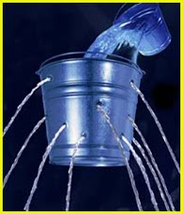
Churn model
The predictive Model will find a pattern in the features of customers who have left in the past and find similar pattern in existing customers, to send alert if it finds that a customer is potentially going to leave
This enables the management to take necessary retention measures
Detect and block the leakage

Slide 25
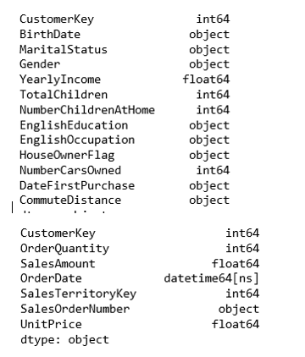
Exploratory Data Analysis
The target variable is churn, where zero is the customers who made purchases in the last 8 months (non-churner), and 1 is customers who did not (churner).
Features from the DimCustomer and FactInternetSales tables are identified to train the model
The following types of data are in the table – datetime, float, integers and objects

Slide 26
RFM Calculation
RFM
R
F
M
FREQUENCY
RECENCY
RECENCY
MONETARY
RFM was used to get customer live time value:
- Recency = Orderdate
- Frequency = OrderQuantity
- Monetary = TotalSum

Slide 27
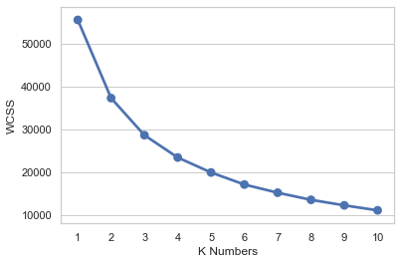
Customer Segmentation with K-Means
So we need to choose the optimized number, and the Elbow method is one of the solutions where we can get the hints.
Customers were segmented into three clusters

Slide 28
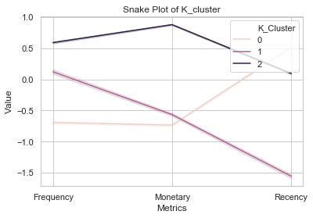
Customer Segmentation with K-Means
For easy comparison of the RFM, snake map and heatmap was used
Cluster 2 delivered the highest revenue which makes it more profitable.

Slide 29
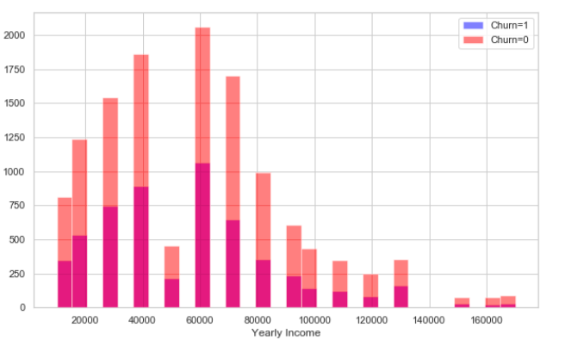
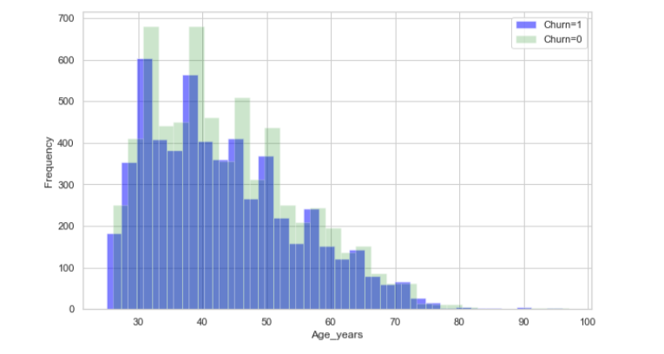
Exploratory Data Analysis
Customer yearly income is one of the determinant of churners the propensity to churn is more with customers with 60,000 yearly income
Most customers are in the age group of 30 to 50

Slide 30
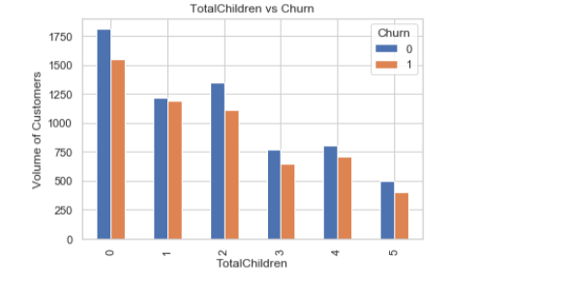
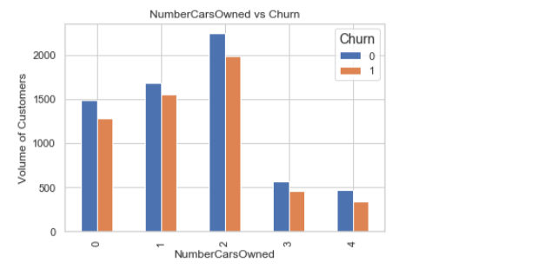
Exploratory Data Analysis
A significant number of loyal customers do not have children
Large number of the Customer has two Cars

Slide 31
Data Splitting
Total Customer
This is the total number of customers .
6,438
Hold Out Data/ Test
50% of Non-Churners dataset. This is what would be used for testing and 50% also for scoring
Train Data
This is the combination of 50% of Non-Churners and 30.3% of Churners making up for our train dataset
12,876
18,484
Churners
5,608
30.3% of the whole dataset.

Slide 32
Variable Selection
Weight of evidence and Information Value
Variable Importance using Random Forest
L1 feature selection
Recursive Feature Elimination
We are going to use regularisation to add penalty in every parameters in the machine learning model, the reason for this is to eliminate overfitting in the model
Variable Importance using Extratrees Classifier
Chi Square
Extratrees classifier perform similarly to RandomForest, the only major difference is the level of variance, of course extratrees show the lowest variance.
We will use chi square to determine which of the features are very relevant to the outcome that will be predicted and remove those that are unimportant for this model

Slide 33

Model selection
53.41%
Neural Network
55.95% Naïve Bayes
67.18% Gradient Boosting
99.40% Random Forest Classifier
57.26% Logistic Regression
The model with the best accuracy will be selected, RandomForestClassifer has 99.40% accuracy which makes it the model for the project

Slide 34
CUSTOMERCIAL RECOMMENDATION/BUSINESS IMPACT

Slide 35


Commercial Impact of Churn
Customers scored – 6,438
Customers likely to churn – 2621
Customers likely to stay – 3,817
Average revenue per customer per year- £1,571
Total revenue loss from customers likely to churn per year is 4,117,591

Slide 36


recommendation
Tightly integrate with marketing team aimed to lure customers with high propensity to churn
Subject to improved result integrate recommendation on online retail platform to flag top three recommendation to each customers
Upon identifying a potential churner, email/post a promotional voucher or discount coupon
Give better service & surpass customers expectation. This key to prevent churning
Ask for feedback and recommendations on product range + specification from customer to engage and revive them
Pay attention to complaints, target right audience, educate & engage customers regularly
Incentives, such as discounts and special offers, to those customers who were identified as likely to defect.
This Photo by Unknown Author is licensed under CC BY
This Photo by Unknown Author is licensed under CC BY-ND

Slide 37

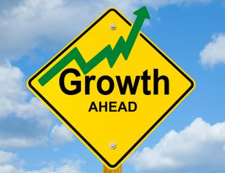

CONCLUSION
There will be great progress and quick positive change in market dynamics, penetration and revenue generation in online business as a results of analytic implemented (recommendation Engine & predictive model).
This Photo by Unknown Author is licensed under CC BY-SA-NC
This Photo by Unknown Author is licensed under CC BY-SA
This Photo by Unknown Author is licensed under CC BY-SA-NC

Slide 38



